Slide 1

Mapping
Mani Amani
May 2025

Slide 2
Background

Slide 3
Probability Basics
Sample Space
Probability Measure
Probability Space

Slide 4
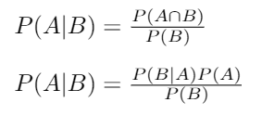
Conditional Probability & Independence
Conditional probability
If we know Event B is true, what is the probability of Event A occurring?
Bayes Rule
likelihood
prior
Assume P(B) > 0
posterior
Notes:
Bayes Rule provides a relationship between the conditional probability mass functions and the marginal probability mass functions of 2 random variables m and z joint pmf of M and Z is p(m,z)) Bayes Rule allows us to switch the order of the r.v. in the conditionals

Slide 5

Bayes Rule
Joint PMF
Marginal PMF
Conditional PMF
Total Probability

Slide 6
Probability Basics
Discrete Random Variable
Cumulative distribution function
Probability distribution function/probability mass function

Slide 7

Frames and Transformations
(0,0)
(0,0)
Red - global frame
Yellow - robot frame

Slide 8
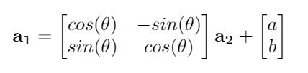
Frames and Transformations
Translational Vector
2D Rotational Matrix
Vector in global frame (output)
Vector in robot frame (input)
Vector <a,b>
Angle θ

Slide 9
Occupancy Grid Mapping

Slide 10
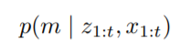
Occupancy Grid Map Scenario
Knowns
Unknowns
Global position of the robot
Range sensor (LiDAR scans)
Map of explored environment with obstacles
Goal: Build a map of the environment
Probability density function for the map (m) given the sensor measurements (z) and robot positions (x) from time=1 to time=t

Slide 11
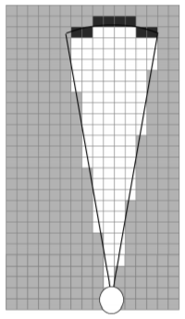
Occupancy Grid Map Scenario
x_{t} - robot position at time t
z_{t} - sensor measurements at time t
m_{i} - map grid cell
m - entire map space

Slide 12
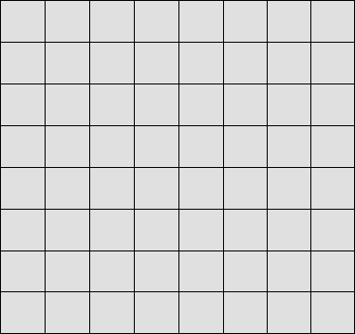
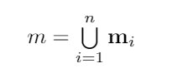
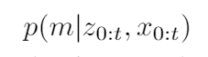
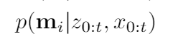
Grid Discretization
Continuous Space
Discrete Space
m - space of map space
m_{i} - space of one grid cell
n - number of grid cells

Slide 13
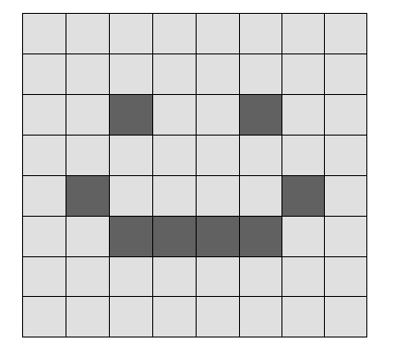
Occupancy Grid Map
Each m_{i} can have a binary state of 0 or 1
Free space represented by m_{i} = 0
Occupied space represented by m_{i} = 1
Goal: want to know p(m_{i} = 1) or p(m_{i}), probability of the grid cell m_{i} is occupied (m_{i} = 1) to approximate the map m
m_{i} - space of one grid cell

Slide 14
Occupancy Grid Map
Each m_{i} is independent from m_{j} (where i ≠ j)
If you don’t check m_{i}, there is no way to know the state of m_{i} based on knowing m_{j} (where i ≠ j)
Even if you know what neighboring cell states are, you cannot predict the state of m_{i} using occupancy grid mapping
Independence between cells simplifies the problem
Only need to track individual cell info, not relations/connections between cells
m_{i} - space of one grid cell

Slide 15
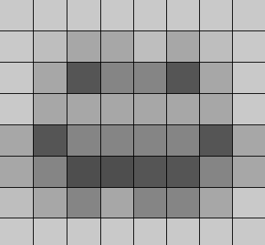
Occupancy Grid Map
p(m_{i} | z_{0:t} , x_{0:t}) - probability that the grid cell m_{i} is occupied, 0<= p(m_{i} | z_{0:t} , x_{0:t}) <=1
Can adjust p(m_{i} | z_{0:t} , x_{0:t}) based on:
z_{0:t} - measurements from our sensor (taken at a certain time) that detect whether there is an object occupying that space
x_{0:t} - positions of our robot at different times (robot trajectory) that include global position coordinates and orientation of the robot
p(m_{i}) - probability that this grid cell is occupied

Slide 16
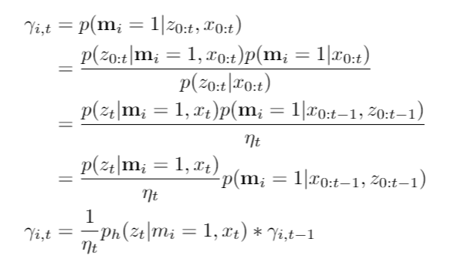
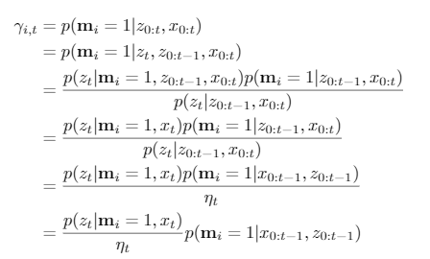
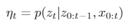
Bayes Rule and Mapping
We will call our pmf γ_{i,t}
Apply Bayes rule (w/ cond. prob.)
Simplify w/ Markov assumptions
Create recursive definition for γ_{i,t}
p_{h} is a label so we can reference this pmf more easily

Slide 17
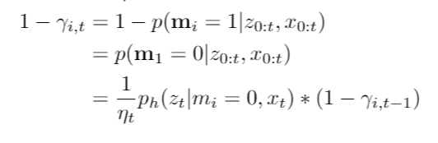
Bayes Rule and Mapping Complement
We want to write a similar recursive expression for p(m_{i} = 0 | z_{0:t} , x_{0:t} )
Apply definition of a complement
Use recursive definition for γ_{i,t} found on previous slide

Slide 18
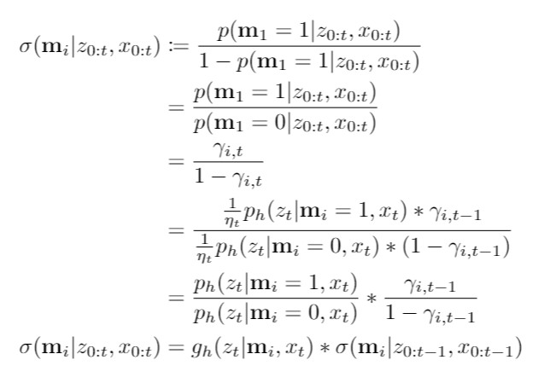
Mapping and Odds Function
Define a function σ(E) = p(E) / (1 - p(E))
Apply definition of a complement
Use relations from previous two slides
Expand using relations from previous two slides
Recursive definition for σ(E) g_{h}(z_{t} | m_{i} , x_{t} ) is the updating factor

Slide 19
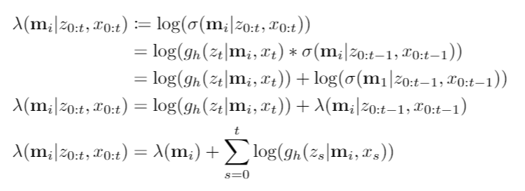
Mapping and Log-Odds Function
Use definition of σ(E) from prev slide
Recursive definition of λ(E)
Explicit definition of λ(E) where λ(m_{i}) is the log-odds of the initial probability of m_{i} being occupied before any measurements

Slide 20
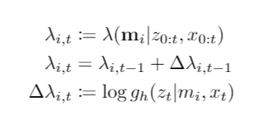
Mapping and Log-Odds Update
Here we simplify notation by defining λ_{i,t}
We rewrite the recursive definition of our log-odds function here.
We want to determine how to calculate the change in λ_{i,t} (update from previous log-odds to new log-odds)

Slide 21
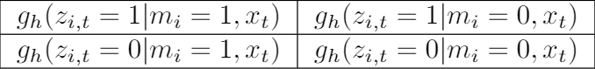
Inverse Sensor Model Concept
True Positive - sensor detects an occupied cell when the cell is occupied
False Positive - sensor detects an occupied cell when the cell is free
False Negative - sensor detects a free cell when the cell is occupied
True Negative - sensor detects a free cell when the cell is free
We can define our sensor model by defining these four probability values, can be obtained experimentally or defined theoretically.

Slide 22
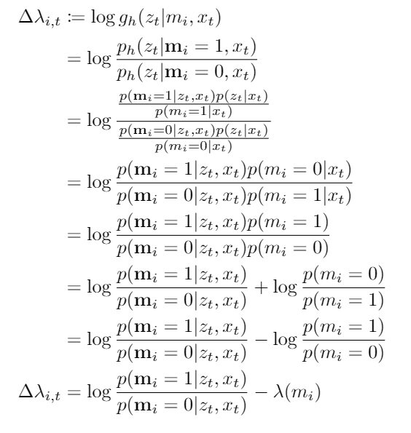
Inverse Sensor Model (Log-odds Update)
g_{h} tells us how likely our measurement if we know the map occupancy state and robot position
Use definition of g_{h} from “Mapping & Odds Function”
Expand with Bayes Rule
Simplify with Markov assumption
Substitute with previous definition of λ(m_{i})

Slide 23
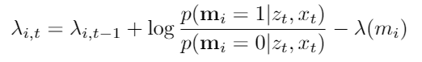
Occupancy Grid Mapping Summary
We have now rewritten the recursive relationship in a more useful form.
The previous form included g_{h} (z_{t} | m_{i} , x_{t}), which depends on knowing the state of m_{i} the exact value we are trying to determine.
If we start with some initial λ_{i,0,} , then we can use this relation to update the λ_{i} (log-odds value of map cell m_{i}) for every time step until we reach λ_{i,t}.

Slide 24
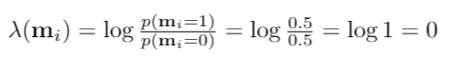
Initial Log-Odds Value
What is the initial log-odds value of the cell m_{i} before we have taken any measurements with our robot?
If we have no information about cell m_{i}
then we can choose to assume there is equal likelihood of m_{i} being occupied and of m_{i} being free. λ(m_{i}) = 0
If we are optimistic about cell m_{i} being occupied (without measuring anything), then λ(m_{i}) can be greater than 0. If we are optimistic about cell m_{i} being free, then λ(m_{i}) can be less than 0.

Slide 25
Implementation

Slide 26
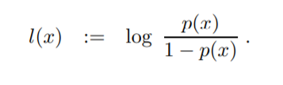
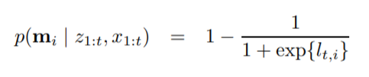
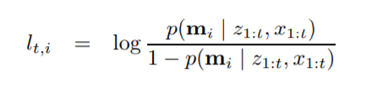
Probability as Log-Odds
Probability ➝ Log-odds
Log-odds ➝ Probability
Log-odds l(x): (-inf, inf)
Probability p(x): [0,1]
Using log-odds instead of probabilities removes the potential rounding errors for floats close to 0 or 1

Slide 27
Bresenham’s Algorithm Introduction
Describes a way to take a continuous line segment/vector and graphically represent it using pixels
Helpful for mapping because we take a LiDAR ray (continuous line segment) and want to know which grid cells (pixels) it passes through

Slide 28
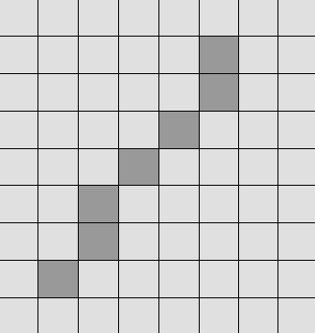
Bresenham’s Algorithm Intuition
For every 1 unit increase in y
Which x-value (x₀ or x₀+1) is closer to the continuous value y(x)?
If x₀ is closer to y(x), choose (x, y) as our pixel, otherwise choose (x₀+1, y) as our pixel.
Keep repeating until we reach end point
(6,8)
(1,1)

Slide 29
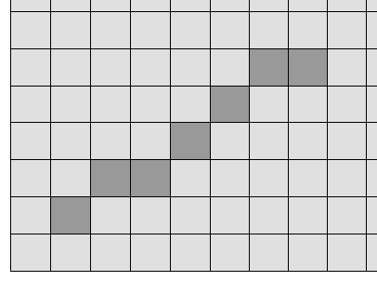
Bresenham’s Algorithm Scenarios
In general, the x or y direction with the greater change is used as the increment by 1 direction.
(6,8)
(8,6)
(1,1)
(1,1)
m > 1, want to increment by y and compare x values
m < 1, want to increment by x and compare y values

Slide 30
Bresenham’s Algorithm
Algorithm Bresenham (x1, y1, x2, y2) {
x = x1; y = y1;
dx = x2 - x1; dy = y2 - y1;
p = 2*dx - 2*dy // indicates the closer y value while ( x < x2) {
add (x,y) to pixel_list
x++;
if ( p<0 )
p = p + 2*dy;
else
p = p + 2*dy - 2*dx;
y++;
}
}
(8,6)
(1,1)
Bresenham (1,1,8,6)

Slide 31
Bresenham’s Algorithm Notes
Where did the derivation of p come from? Reference
Remember we can find the closer value by plugging in y(x₀) and y(x₀+1) and pick the closer one found from y = mx+b
Derivation comes from manipulation of y=mx+b and m = y/x —> why manipulate? To avoid using floats (calculation inaccuracies, more expensive operations)
How would you use Bresenham’s algorithm for vectors in different quadrants?
E.g. positive dx and positive dy vs. negative dx and positive dy scenarios

Slide 32
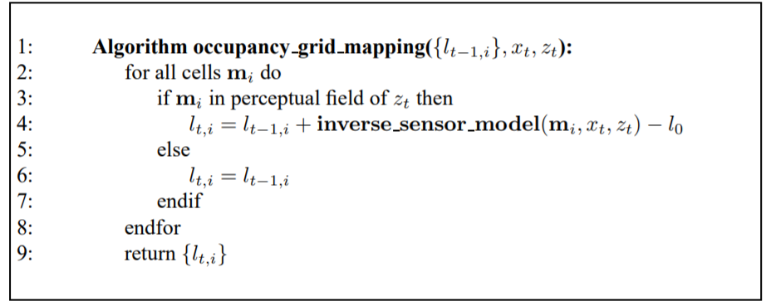
Occupancy Grid Mapping Pseudocode

Slide 33
Occupancy Grid Mapping Examples

Slide 34
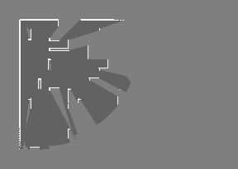
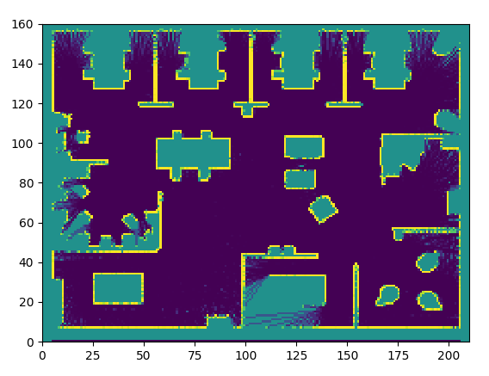
Occupancy Grid Map
Fig.2.1 Occupancy grid map
Fig.2.2 Occupancy grid map from sample data

Slide 35
Occupancy Grid Map Simulation
Fig.2.3 Simulation Example
Fig.2.4 Log-odds map from example

Slide 36

Bresenham’s Algorithm
(6,8)
(6,8)
(1,1)
(1,1)

Slide 37
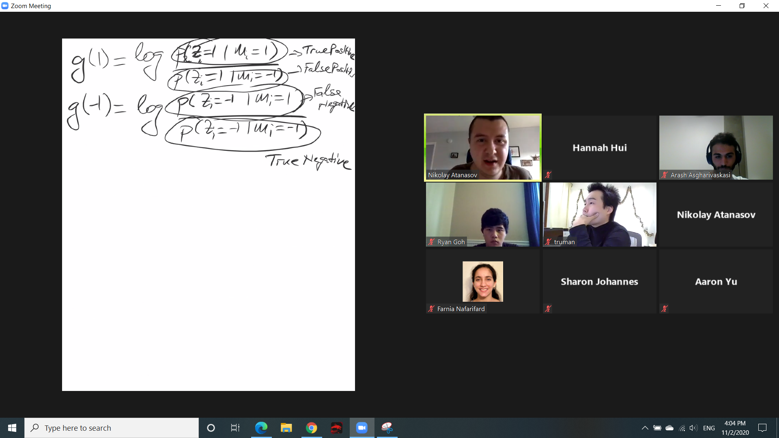
Sensor Model
Models allow us to connect our specific robot behaviors/attributes to the general algorithm.
x_{t} (robot positions) and z_{t} (sensor measurements) used to update m_{i} (any grid cell).
Things that can affect chosen sensor model: type of sensor (e.g. LiDAR), sensor position on robot, etc.

Slide 38
Thank you!

